Slide 1
Facilitating Development for all of Us STE Gurgaon 2019

Slide 2
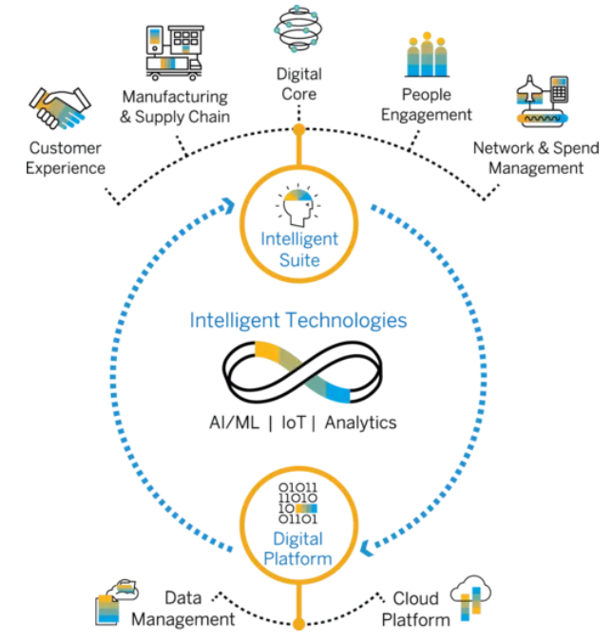
Faster Upskilling – Customized Learning Paths
Current State:
Increasing need of upskilling in organization due to rapid changes in technology
Main questions – What to learn, proficiency level, what next?
“Jack of All Trades” or “Master of One”?

Slide 3
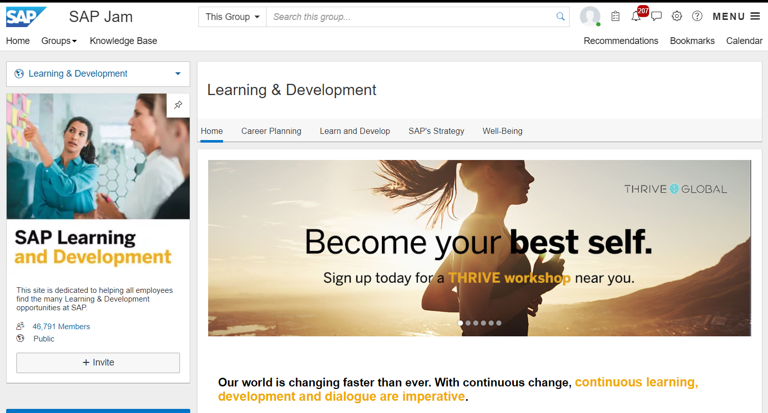
Available Resources – SAP Learning & Development

Slide 4
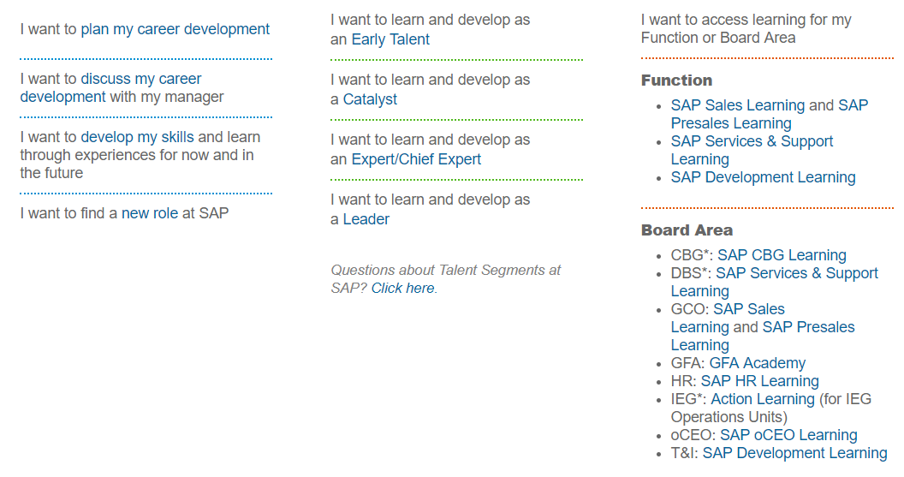
Available Resources – SAP Learning & Development

Slide 5
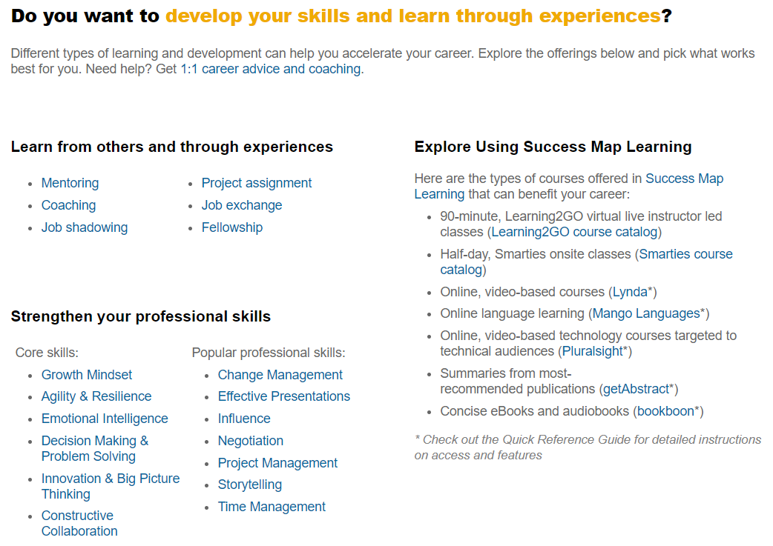
Available Resources – SAP Learning & Development

Slide 6

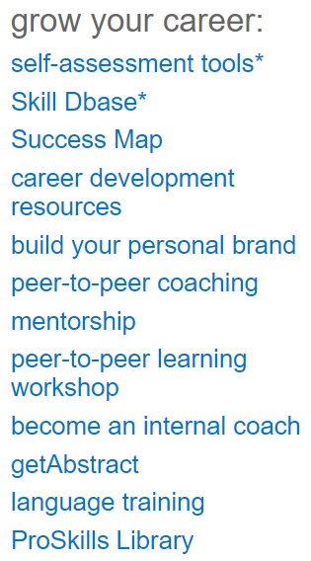
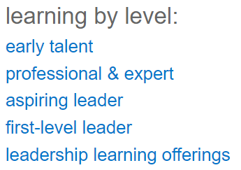
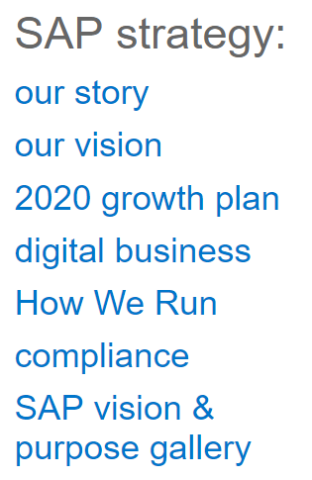
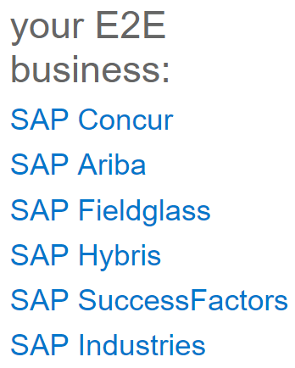
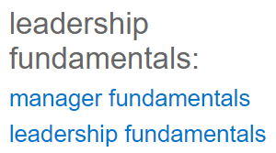
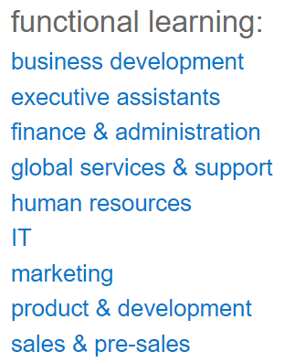
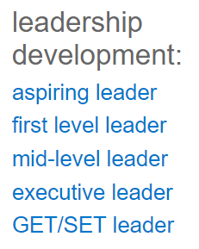
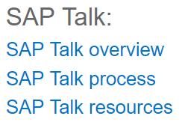
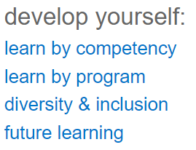
Available Resources –
CBG Group

Slide 7
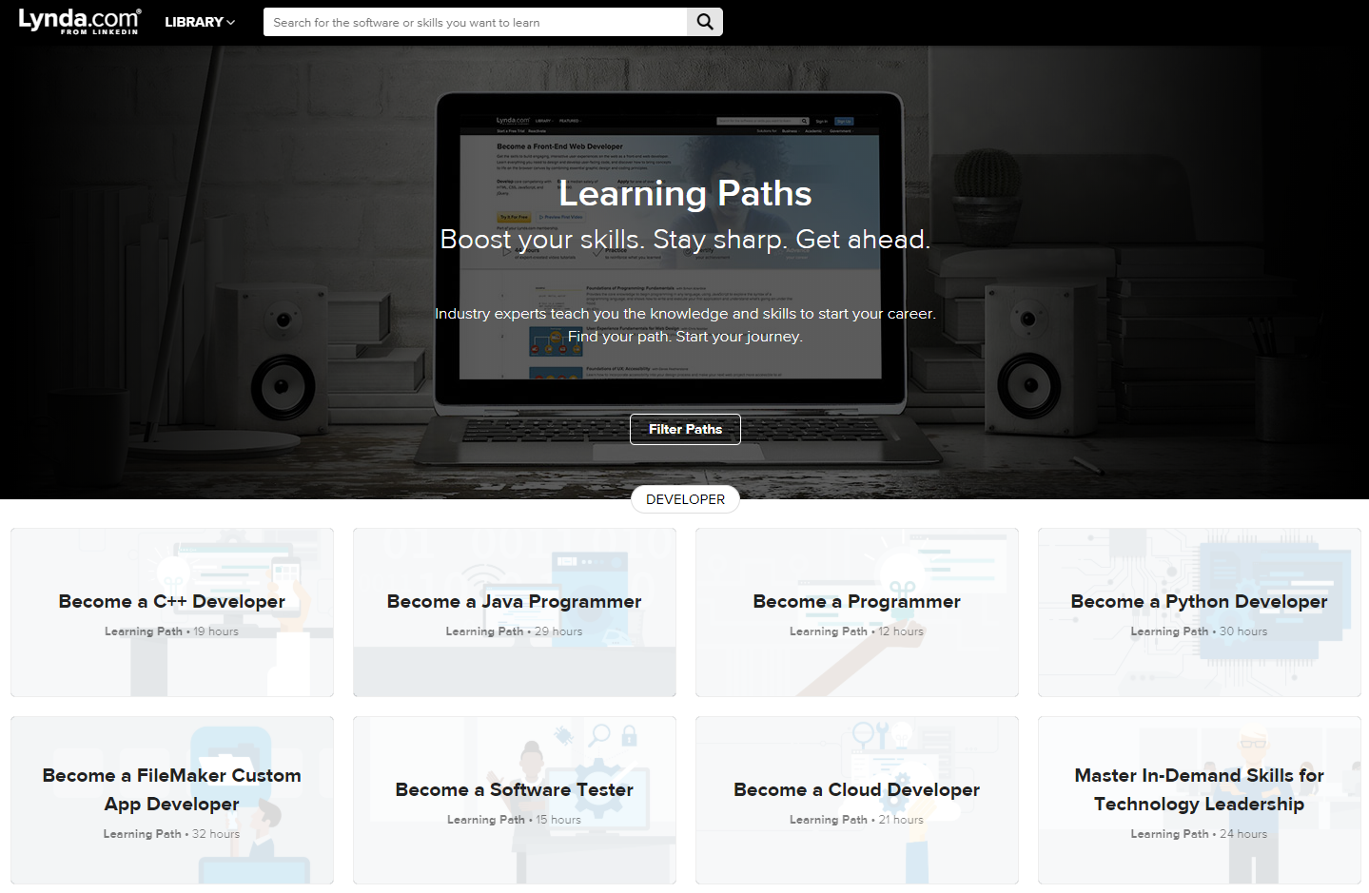
Available Resources – Lynda – Learning Paths

Slide 8
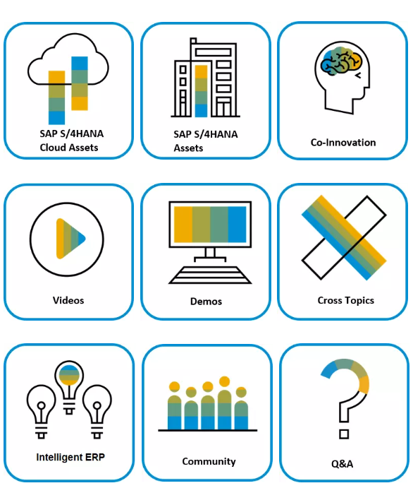
Available Resources –
S/4HANA Product Management & Co-Innovation

Slide 9
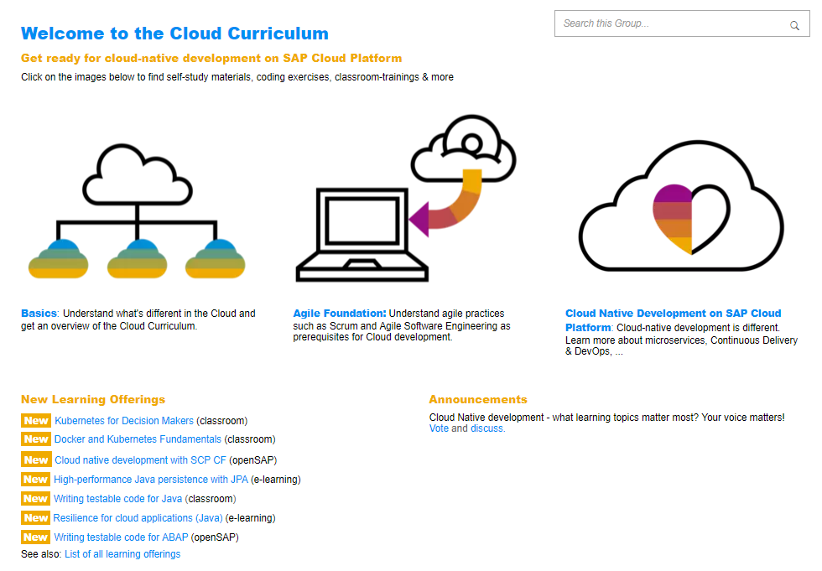
Available Resources –
Cloud Curriculum for Development

Slide 10

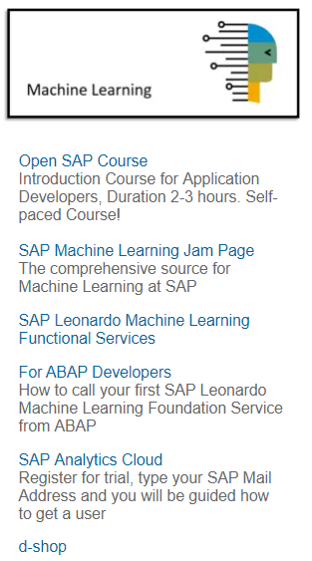
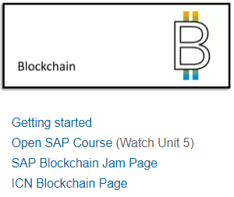
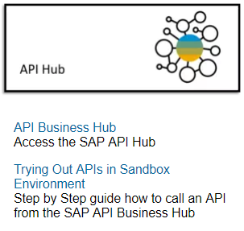

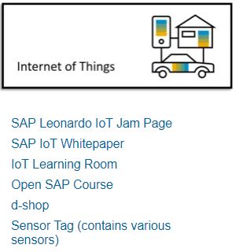
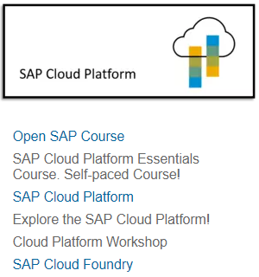
Available Resources –
Phoenix Initiative

Slide 11
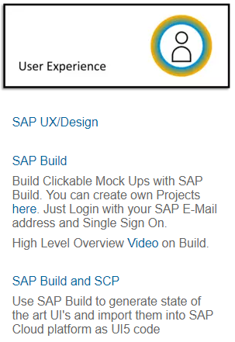
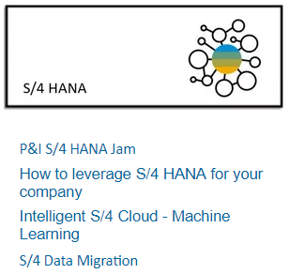

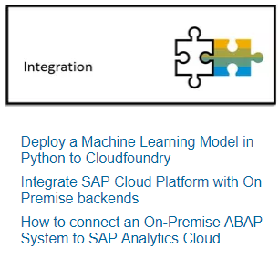
Available Resources –
Phoenix Initiative

Slide 12
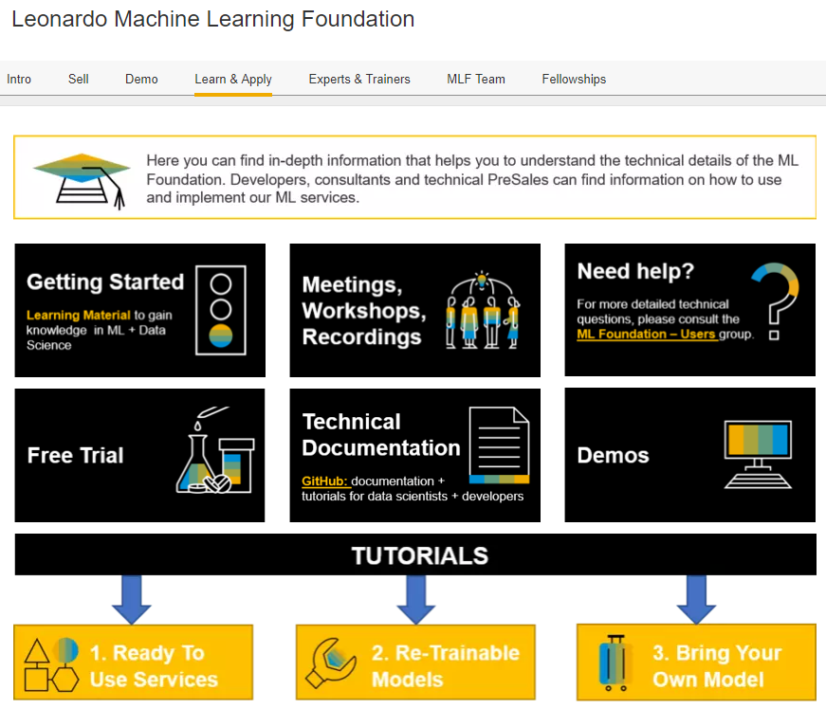
Available Resources –
Leonardo Machine Learning Foundation

Slide 13
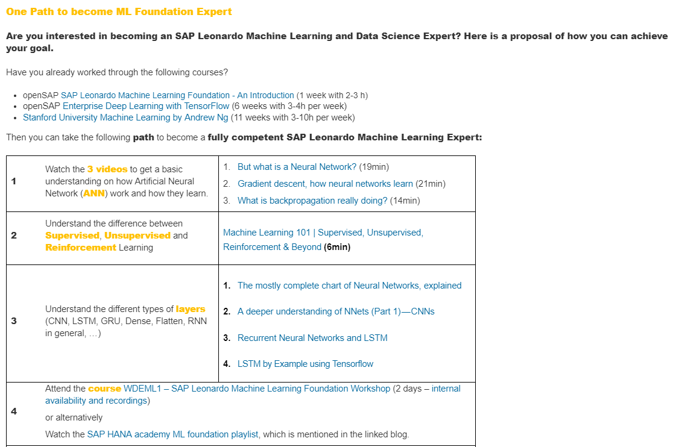
Available Resources –
Leonardo ML Foundation - Getting Started

Slide 14
Available Learning Resources – Machine Learning
Basic ML Know-how
Artificial Intelligence Foundations: Thinking Machines with Doug Rose
Artificial Intelligence Foundations: Machine Learning with Doug Rose
Artificial Intelligence Foundations: Neural Networks with Doug Rose
Python Statistics Essential Training with Michele Vallisneri
NumPy Data Science Essential Training with Charles Kelly
pandas Essential Training with Jonathan Fernandes
Machine Learning & AI Foundations: Linear Regression with Keith McCormick
Machine Learning & AI: Advanced Decision Trees with Keith McCormick
Machine Learning and AI Foundations: Classification Modeling with Keith McCormick
Machine Learning and AI Foundations: Clustering and Association with Keith McCormick
Machine Learning and AI Foundations: Decision Trees with Keith McCormick
Machine Learning and AI Foundations: Predictive Modeling Strategy at Scale with Keith McCormick
Machine Learning and AI Foundations: Recommendations with Adam Geitgey
Machine Learning and AI Foundations: Value Estimations with Adam Geitgey
Advanced Topics
Neural Networks and Convolutional Neural Networks Essential Training with Jonathan Fernandes
Building and Deploying Deep Learning Applications with TensorFlow with Adam Geitgey
Building Deep Learning Applications with Keras 2.0 with Adam Geitgey
Deep Learning: Face Recognition with Adam Geitgey
Deep Learning: Image Recognition with Adam Geitgey
Deploying Scalable Machine Learning for Data Science with Dan Sullivan
Designing for Neural Networks and AI Interfaces with Emmanuel Henri
Learning TensorFlow with JavaScript with Emmanuel Henri
NLP with Python for Machine Learning Essential Training with Derek Jedamski
OpenCV for Python Developers with Patrick W. Crawford
Spark for Machine Learning & AI with Dan Sullivan
Ramp up on SAP Intelligent Enterprise
SAP Leonardo - Enabling the Intelligent Enterprise
SAP Leonardo Machine Learning Foundation – An Introduction
Enterprise Machine Learning in a Nutshell (Repeat)
Enterprise Deep Learning with TensorFlow
Analytics with SAP Cloud Platform
Text Analytics with SAP HANA Platform
SAP Cloud Platform Essentials (Update Q2/2019)
How to Deliver Intelligent Enterprise ML Use Cases
Leonardo Machine Learning Foundation
The Intelligent ERP Program
Innovation Information Sessions
Cloud Curriculum for Development
Phoenix Initiative
S/4HANA PM Machine Learning CoE

Slide 15
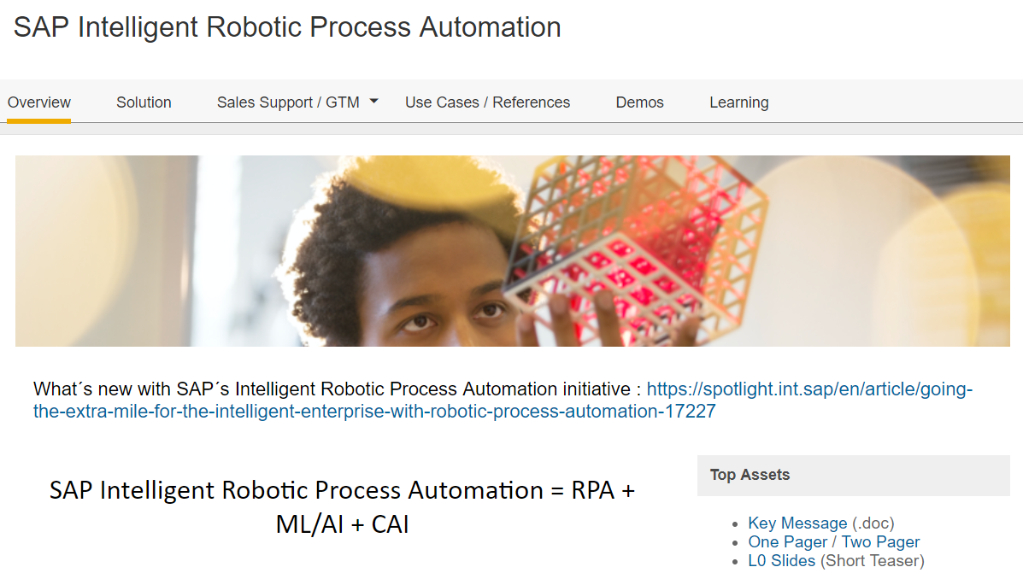
Available Resources –
IRPA

Slide 16
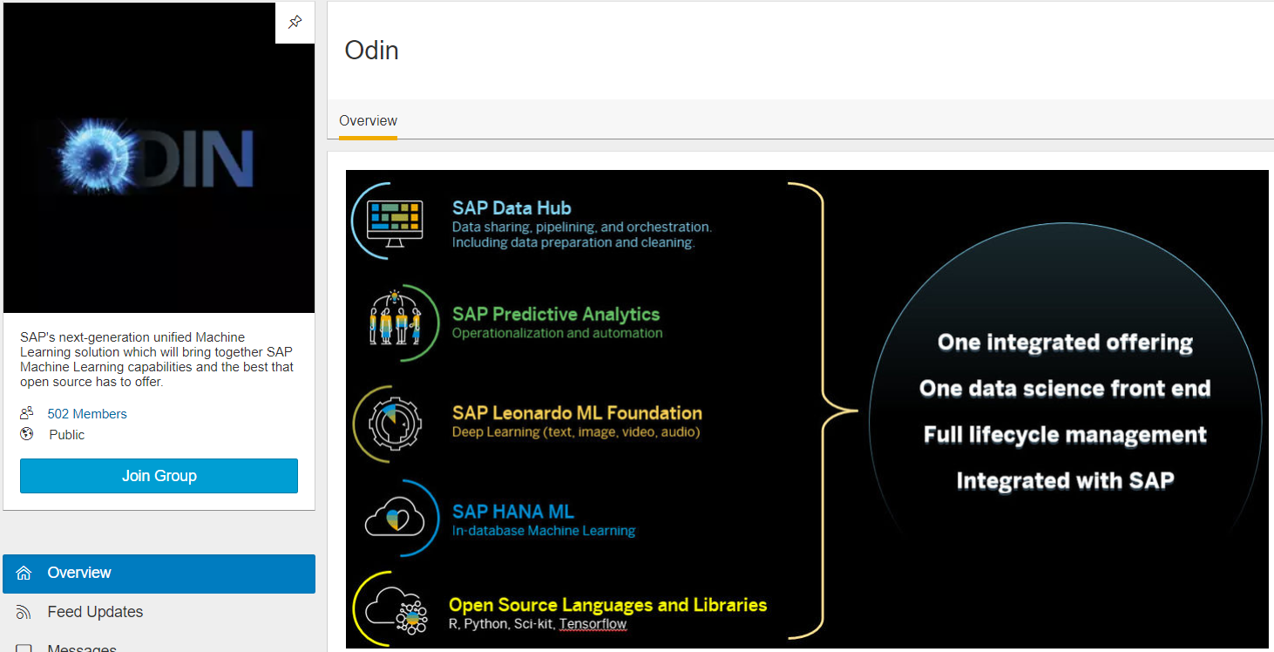
Available Resources –
ODIN

Slide 17
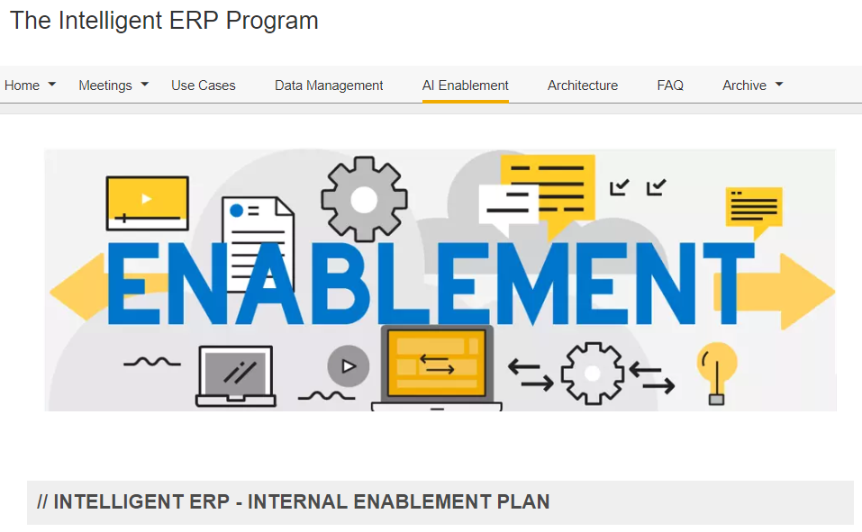
Available Resources –
Intelligent ERP Program Enablement

Slide 18
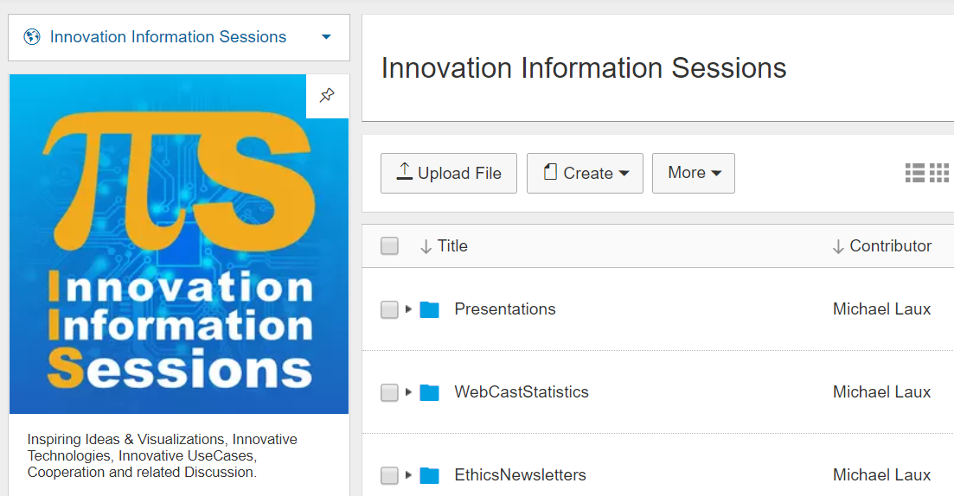
Available Resources –
IIS

Slide 19
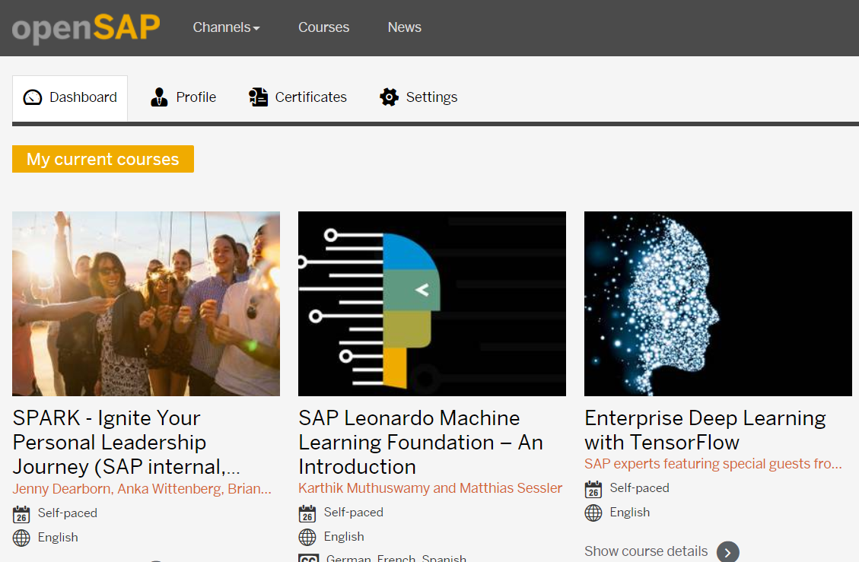
Available Resources –
openSAP

Slide 20
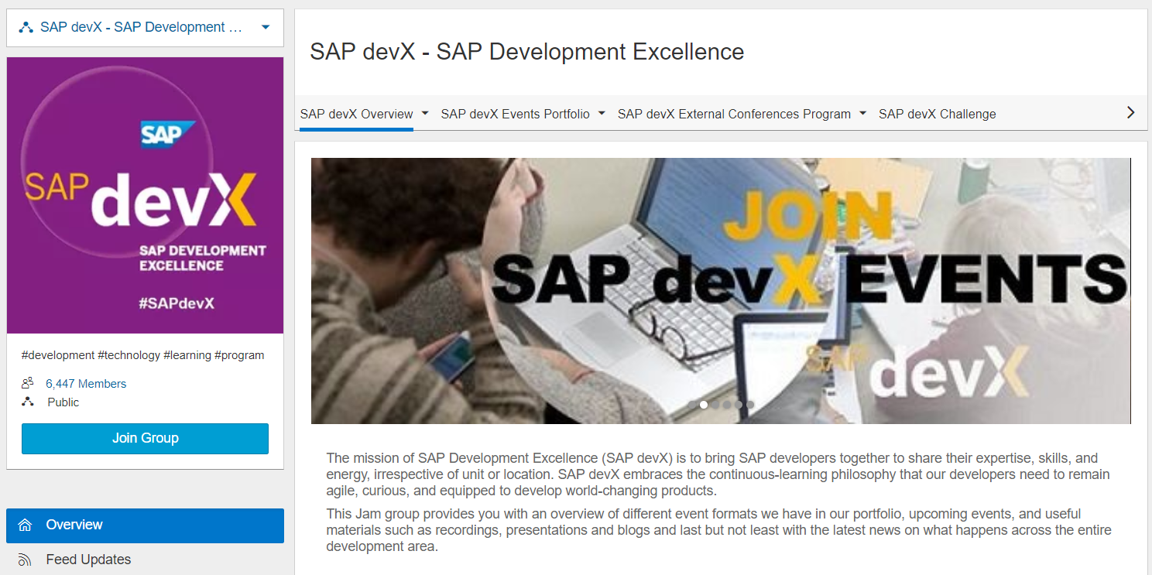
Available Resources – SAP devX

Slide 21
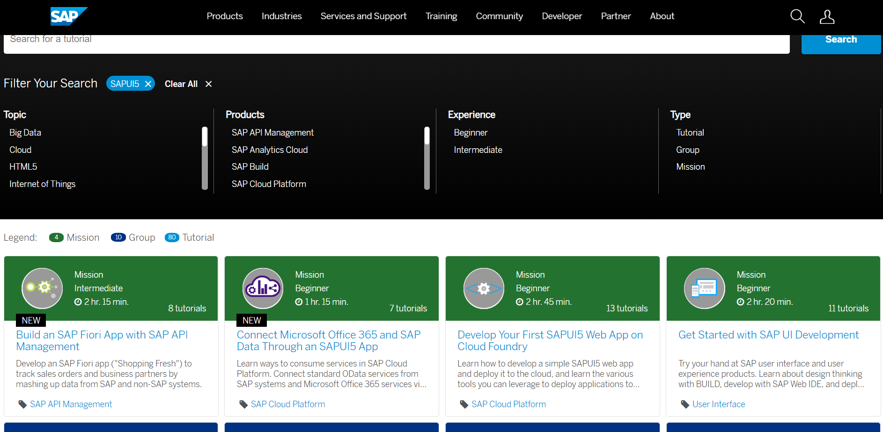
Available Resources – developers.sap.com tutorials

Slide 22
Upskilling for Impact
Sl # | Technology/ Tool | Learning Source | Role
1 | CDS Views/ODATA | SAP Success Map Learning : COURSE SER_BPPOS4H_21_1710_WBT SAP Gateway - Building OData Services(RESOURCE LH_GW100_EN_Col15) | UI5 Developer
2 | JavaScript | http://javascript.info/
3 | HTML5/UI5 | https://www.javatpoint.com/html-formatting
4 | Fiori Development (Incl. Guidelines, Design Principles) | https://open.sap.com/courses/fiux2 https://www.tutorialspoint.com/sap_fiori/sap_fiori_launchpad.htm
5 | Basic Java | https://www.learnjavaonline.org/ | Test Automation Expert
6 | Selenium | https://www.guru99.com/selenium-tutorial.html
7 | JAVA | Java Beginners Guide – Eighth Edition (Herbert Schildt) | Application Developer
8 | ABAP | SAP Success Map Learning, BC_100, BC_400 PDF doc.
9 | ML Basics + NLP | openSAP SAP Leonardo Machine Learning Foundation - An Introduction openSAP Enterprise Deep Learning with TensorFlow Stanford University Machine Learning by Andrew Ng | Emerging Technology Expert
10 | Python | https://www.learnpython.org/
11 | SAP Cloud Platform | SAP Success Map Learning : COURSE SALES_80001518_EN_1702 | Platform Expert
12 | SCP Cloud Foundry | SAP Success Map Learning : COURSE DEV_5000480046_EN_ILT
13 | SAP App Business Hub | https://blogs.sap.com/2017/11/20/getting-started-with-sap-api-business-hub/

Slide 23
Enabling Your Development
Learning and Development culture
Identification of development needs – strengths and skills
Common Trainings, sessions
Opportunities at job function
Opportunities outside job function
Soft skills development
Stretch assignments

Slide 24
Thank you.

